Slide 1
Project Assignment Manager
Team 5main
Presenters:HyeJee Choi
Team members:JunHyuk Jeong
SuHyeon Ra
JuYeon Lee
NaHyun Meang
SuHyeon Ra

Slide 2
Project Overview-Vision
1. Problem Statement&Solution
Students are suffering more and more as semester goes by. Because their assignments and confusion will be more and more
-> ‘Assignment Manager’ helps them remember what to do today
2. Assumptions and Constraints
Assumptions : Users are all Students

Slide 3
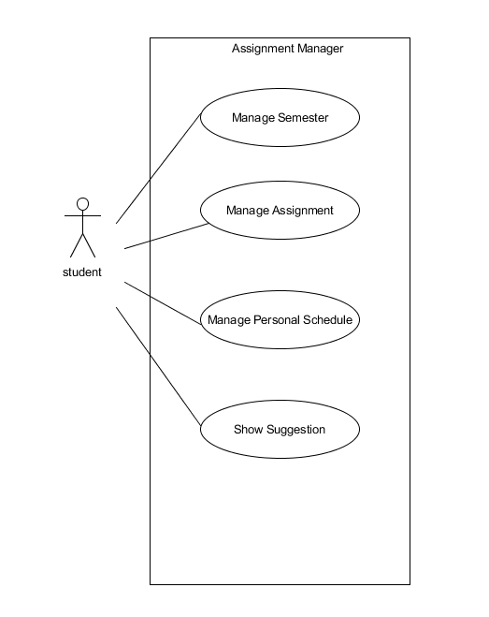
Requirements & Analysis
1. Use Case Diagram

Slide 4
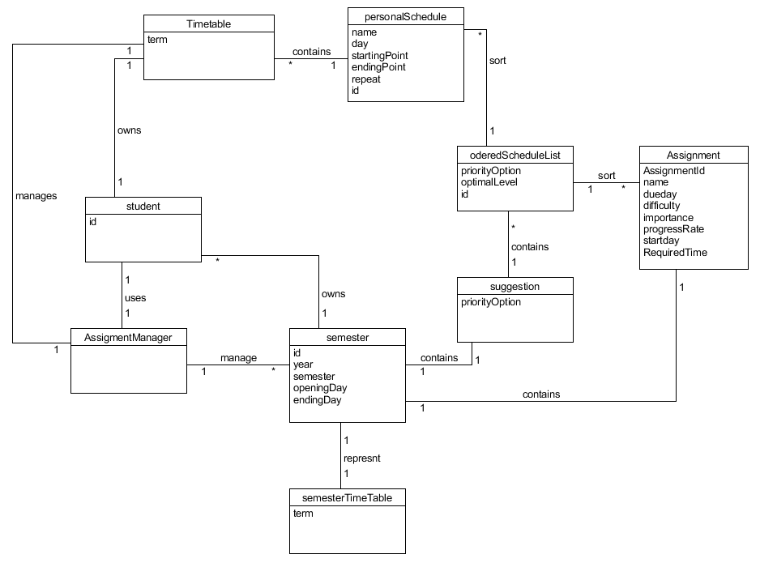
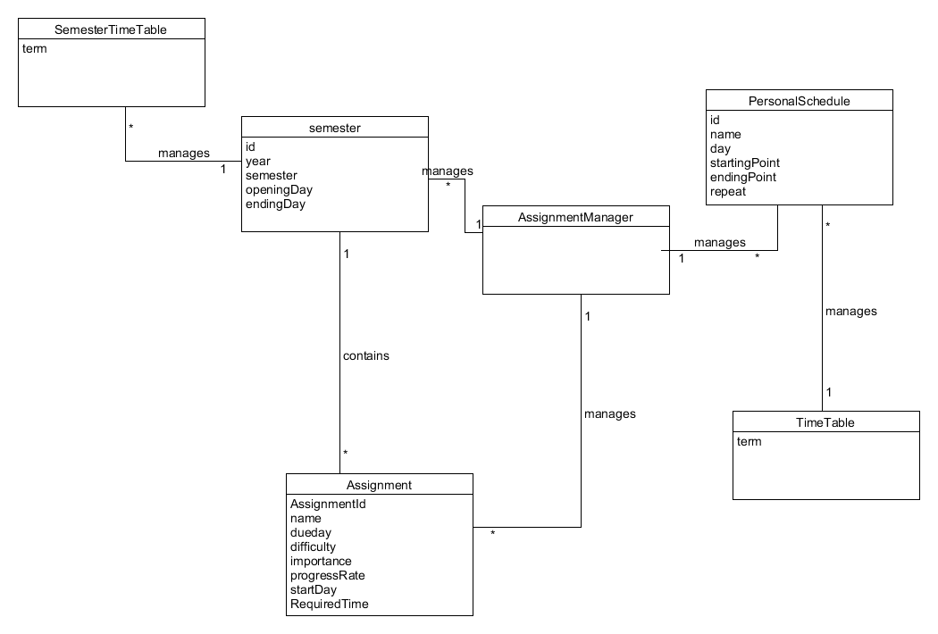
Requirements & Analysis
Domain Model Diagram of use case 1,2, and 3
2. Domain Model diagram
Domain Model Diagram of use case 4

Slide 5
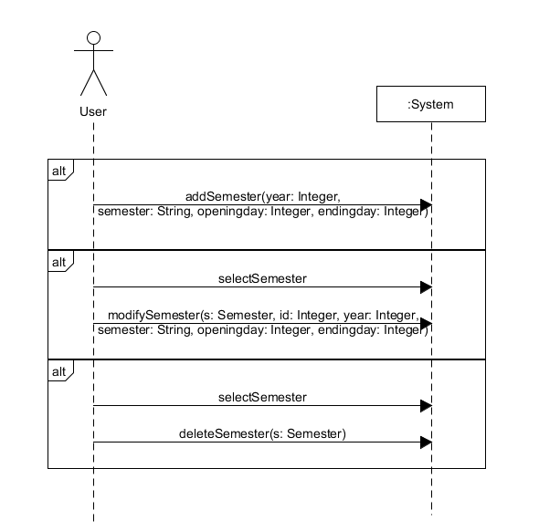
Requirements & Analysis
3. System Sequence Diagram
System Sequence Diagram of use case 1

Slide 6
Requirements & Analysis-OC1
1. Operation: addSemester(id: Integer, year: Integer, semester: String, openingday: Integer, endingday: Integer) 2. Cross references: Manage Semester 3. Precondition 1. System is already started running, 2. Option Screen is showed. 4. Postcondition 1. A Semester instance s was created(instance creation). 2. s was associated with the current semester(association formed). 3. s.attributes(id: Integer, year: Integer, semester: String, openingday: Integer, endingday: Integer) became entered information(attribute modification).

Slide 7
Requirements & Analysis-OC2
1. Operation: modifySemester(year: Integer, semester: String, openingday: Integer, endingday: Integer) 2. Cross references: Manage Semester 3. Precondition 1. System is already started running, 2. Option Screen is showed. 3. Semester is already selected. 4. Semester s has to be exist already. 4. Postcondition 1. s.attributes(id: Integer, year: Integer, semester: String, openingday: Integer, endingday: Integer) are changed into entered information(attribute modification).

Slide 8
Requirements & Analysis-OC3
1. Operation: modifySemester(s: Semester)
2. Cross references: Manage Semester
3. Precondition:
1. System is already started running,
2. Option Screen is showed.
3. Semester is already selected.
4. Semester s has to be exist already.
4. Postcondition
1. Semester object s has deleted.

Slide 9
Part 2: Software Architecture

Slide 10
Architectural Factors and brief resolutions (major ones)
Factor | Measures and quality scenarios | Variability | Impact of factor | Priority for success | Difficulty or Risk
Reliability-Recoverability
Recovery from DB failure | When user fails to save the data to DB, system retry to save data within 1 minutes. | Current flexibility: - After few minutes later, reconnection is possible Evolution: - None | Higher impact on the large-scale design. Students may not use this program. | H | M
Recovery from Algorithms failure | When system fails to analyze the assignments, error information is sended to manager and manager confirm. | Current flexibility: - Error information is sended to manager Evolution: - None | As above | H | H

Slide 11
Performance-Response Time
Reduce Response Time | System answer the user’s request within 0.5 seconds | Current flexibility: - It is possible within 0.5 seconds for 90% Evolution: - It is possible within 0.5 seconds for 95% | Influence on design is small | M | M
Supportability-Maintainability
Support user’s problem | When user sends an e-mail to manager, manager answers within 24 hours. | Current flexibility: - Manager answers within 24 hours Evolution: - None | Impact is small | H | M

Slide 12
Issue : Performance-Reduce Response Time
Solution Summary
- When over response time, it is sended to error log.
Factor :
- Reduce response time as possible.
Solution :
- When the response time do not satisfy condition, it is sended to error log. The log sends to manager in real time automatically.
Motivation :
- If response time is too long, user can not satisfy with this program.
Unresolved Issues, Alternatives Considered :
- None.
Notes:
//여기까지 아마도 나수현???

Slide 13
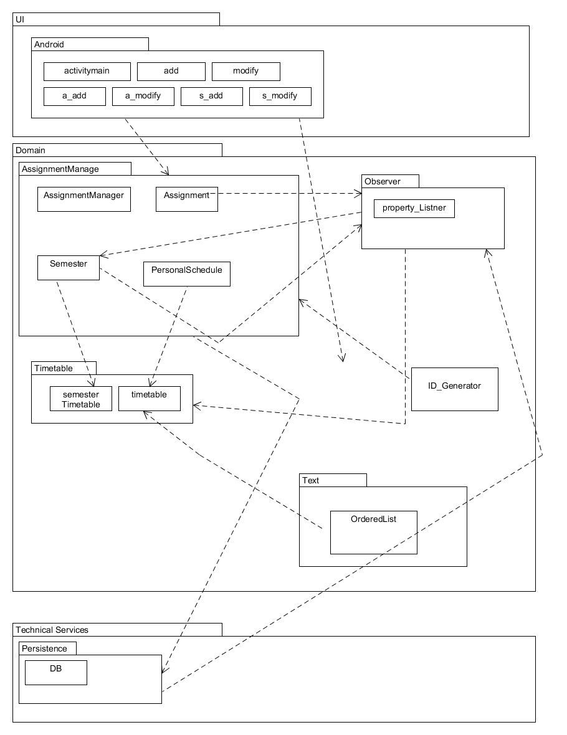
Logical View

Slide 14
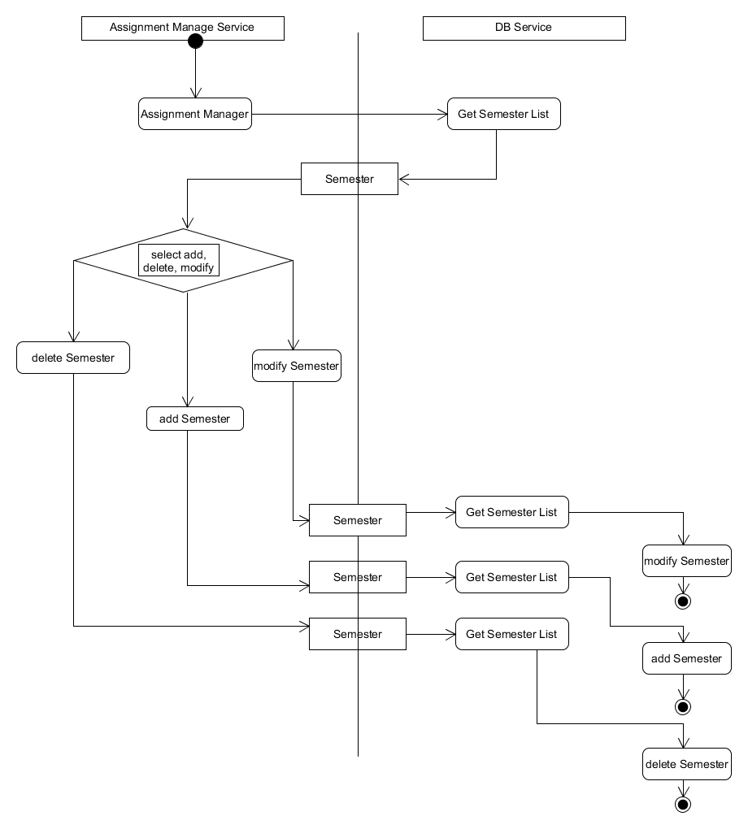
Process View

Slide 15
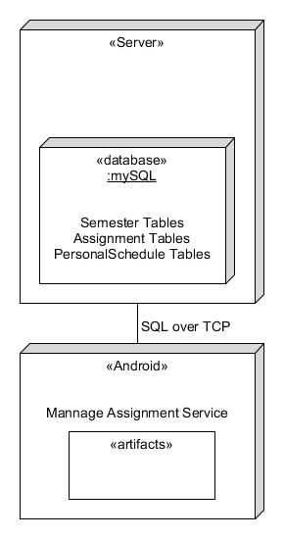
Deployment View

Slide 16
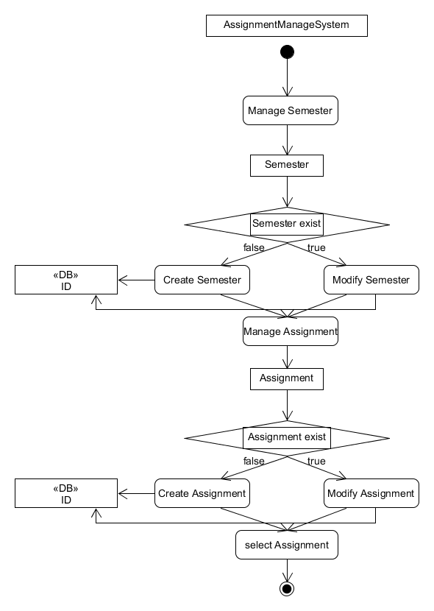
Data View

Slide 17
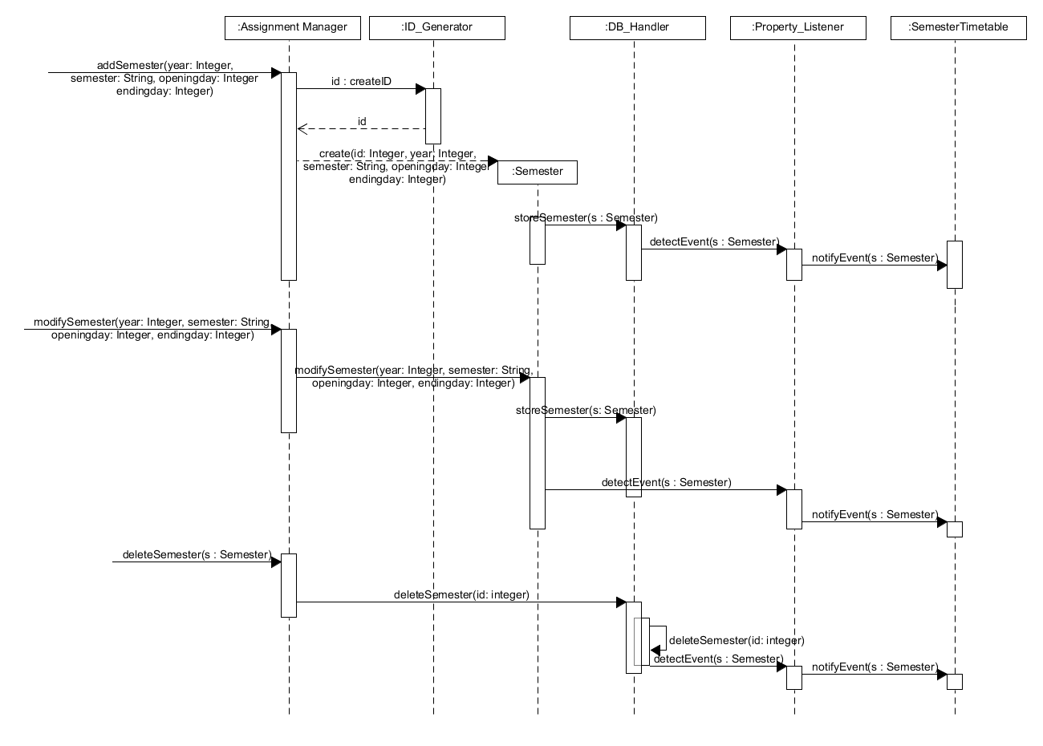
Part 3: Design model 1
combined DSD for Manage Semester
Notes:
Behavioral Design model for elaboration phase 2
-Use case Design modeling (1 new/updated major)
Design Sequence Diagrams

Slide 18
Part 3: Design model 2
GRASP pattern | Explain
creator | Semester creates Semester object s.
GRASP pattern table for addSemester
GoF pattern | Explain
Observer | Property_Listener detect the occurrence of semester in DB_Handler and notify it to Timetable to show on a screen.
GoF pattern table for addSemester
Notes:
Behavioral Design model for elaboration phase 2
-Use case Design modeling (1 new/updated major)
Pattern’s applied

Slide 19
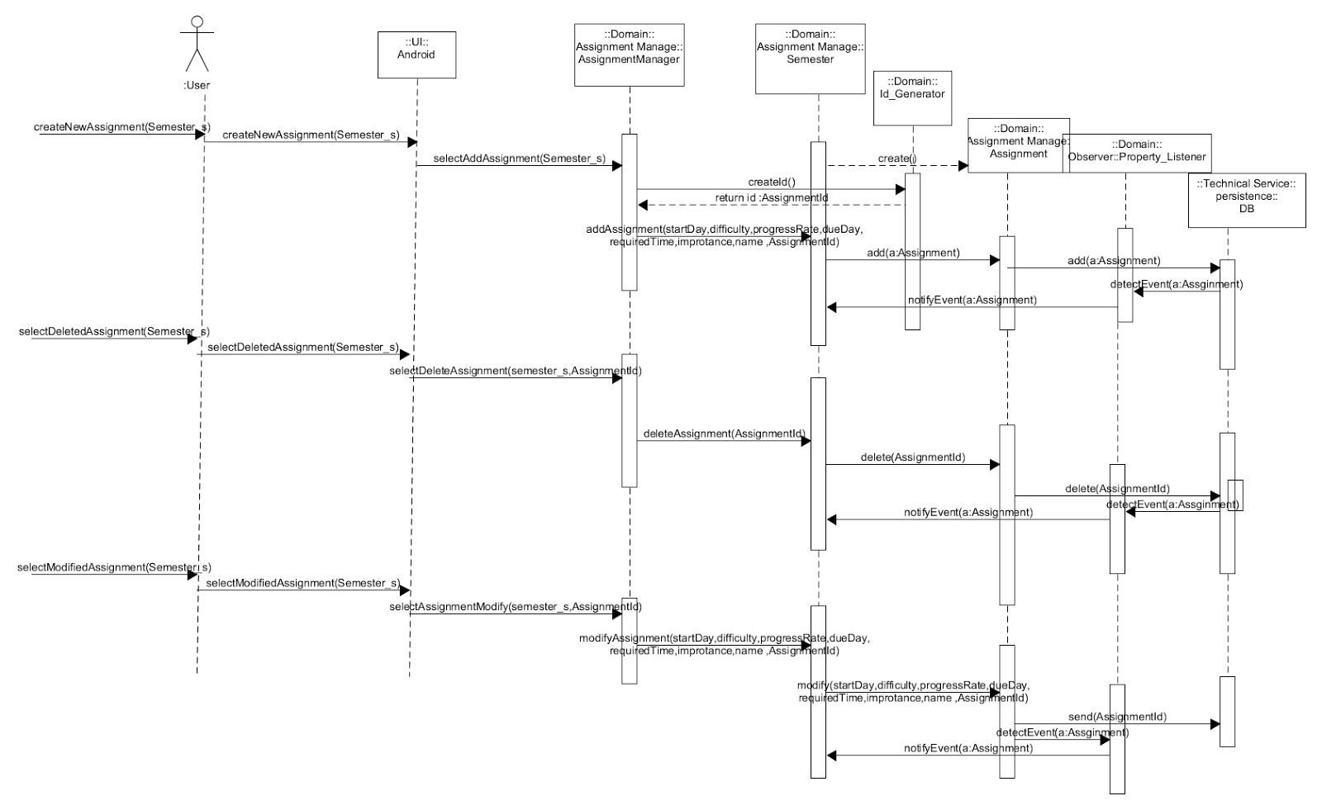
Part 3: Design model 3
manage assignment use case view
Notes:
Behavioral Design model for elaboration phase 2
-Use case Design modeling (1 new/updated major)
Use case view//?????? View 파트 넣는거 맞나?

Slide 20
Current Status
1. Design is 80% done.
Because our design doesn’t include Security/Implementation/Development view.
- UC1. Manage Semester
- UC2. Manage Assignment
- UC3. Manage Personal Schedule
- UC4. Show Suggestion
2. We have done 20% of the implementation. Also, implemented following use case
instances.
- UC1. Manage Semester
- UC2. Manage Assignment
- UC3. Manage Personal Schedule
- UC4. Show Suggestion
Notes:
Describe the changes made to the project scope/requirements, if any

Slide 21
Recommendations
Point out lessons learnt from undertaking this project. Include :
1. When creating a domain model, if you follow a classification or other process in a formal way, it will take less time to modify later.
2. You need to keep a good foundation.

Slide 22
Part 4: Demo of Prototype
High-Level features of User Interface
Feature 1
Feature 2
Feature 2
Etc. // 나현 수정 부탁

Slide 23
Live Demonstration
Prose description of scenario illustrating prototype functionality
-Give live planned demonstration
//발표? 아마도?

